Slide 1
GIBBS PHENOMENON

Slide 2
What is GIBBS PHENOMENON?
For a periodic signal with discontinuities, if the signal is reconstructed by adding the Fourier series, then overshoots appear around the edges. These overshoots decay outwards in a damped oscillatory manner away from the edges. This is known as GIBBS phenomenon.
In this tutorial, as I gave the maximum number of harmonics, the less number of overshoots occured, hence I started from 20 number of harmonics the overshoots are up to the level. when I increase my harmonics ( say 100,120,500 harmonics) my overshoots got minimized and thus I obtained the complete square waveform from sin waveform(at 500 harmonics) without any overshoots thus the Gibbs phenomenon is concluded within.

Slide 3
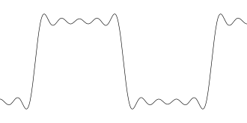
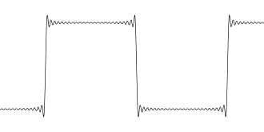
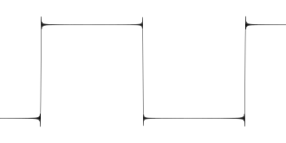
Functional approximation of sine wave using 20 harmonics
Functional approximation of square wave using 120 harmonics
Functional approximation of square wave using 500 harmonics

Slide 4
The sinusoidal components of the signal that occur at multiples of the fundamental frequency are called harmonics . In general, for well-behaved (continuous) periodic signals, a sufficiently large number of harmonics can be used to approximate the signal reasonably well. For periodic signals with discontinuities, however, such as a periodic square wave, even a large number of harmonics will not be sufficient to reproduce the square wave exactly. This effect is known as Gibbs phenomenon and it manifests itself in the form of ripples of increasing frequency and closer to the transitions of the square signal.

Slide 5
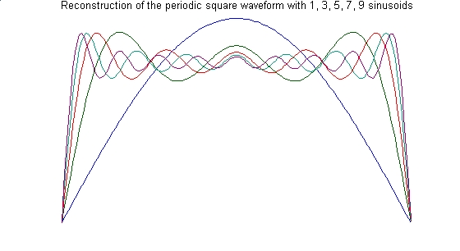
An illustration of Gibbs phenomenon is shown in the figure below. The figure shows the result of adding one, three, five, seven, and nine harmonics. In all cases, and regardless of the number of harmonics, it is observed that the overshoot of the ripples has a constant magnitude (around 18%).

Slide 6
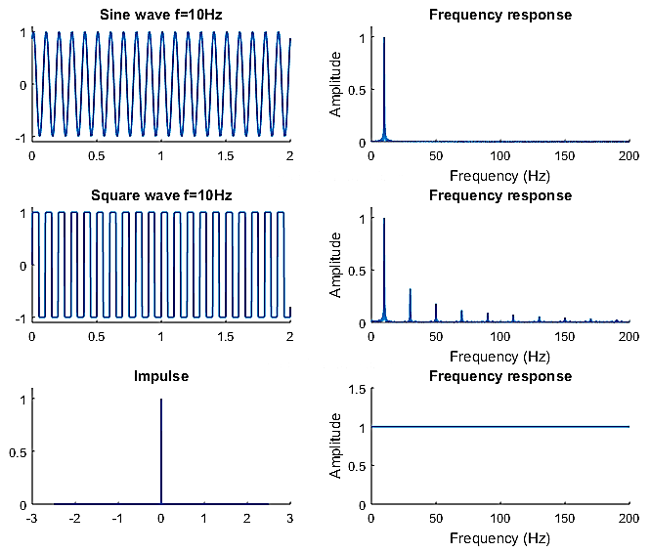
Fourier transform represents signals in frequency domain as summation of unique combination of sinusoidal waves. Fourier transforms of various signals are shown in the Figure. Some of these signals, square wave and impulse, have abrupt discontinuities (sudden changes) in time domain. They also have infinite frequency content in the frequency domain.

Slide 7
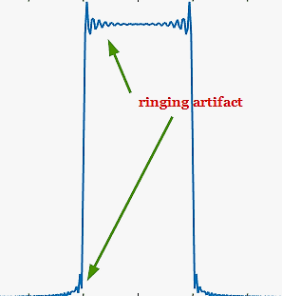
Therefore, abrupt discontinuities in the signals require infinite frequency content in frequency domain. As we know, in order to represent these signals in computer memory, we cannot dispense infinite memory (or infinite bandwidth when capturing/measurement) to hold those infinite frequency terms. Somewhere, the number of frequency terms has to be truncated. This truncation in frequency domain manifests are ringing artifacts in time domain and vice-versa. This is called Gibbs phenomenon.
Figure : Ringing artifact (Gibbs phenomenon) on a square wave when the number of frequency terms is truncate

Slide 8
These ringing artifacts result from trying to describe the given signal with less number of frequency terms than the ideal. In practical applications, the ringing artifacts can result from:-
● Truncation of frequency terms – For example, to represent a perfect square wave, an infinite number of frequency terms are required. Since we cannot have an instrument with infinite bandwidth, the measurement truncates the number of frequency terms, resulting in the ringing artifact.
● Shape of filters – The ringing artifacts resulting from filtering operation is related to the sharp transitions present in the shape of the filter impulse response.

Slide 9
SUMMARY
In this demonstration, a sin pulse in time domain is considered. Sin pulse with infinite duration in time domain, manifests as perfect square shape in frequency domain. In this demo, we truncate the sin pulse in the time domain at various length and use FFT (Fast Fourier Transform) to visualize it frequency domain. As the duration of time domain samples increases, the ringing artifact become less pronounced and the shape approaches ideal brick wall filter response.
This effect due to abrupt discontinuities will exists no matter how large the number of samples is made. The situation can be improved by using a smoothly tapering windows like Blackman, Hamming , Hanning , Keiser windows etc.,

Slide 10
THANK YOU
VAGGE SNEHA
vaggesneha@mail.com

